Slide 1
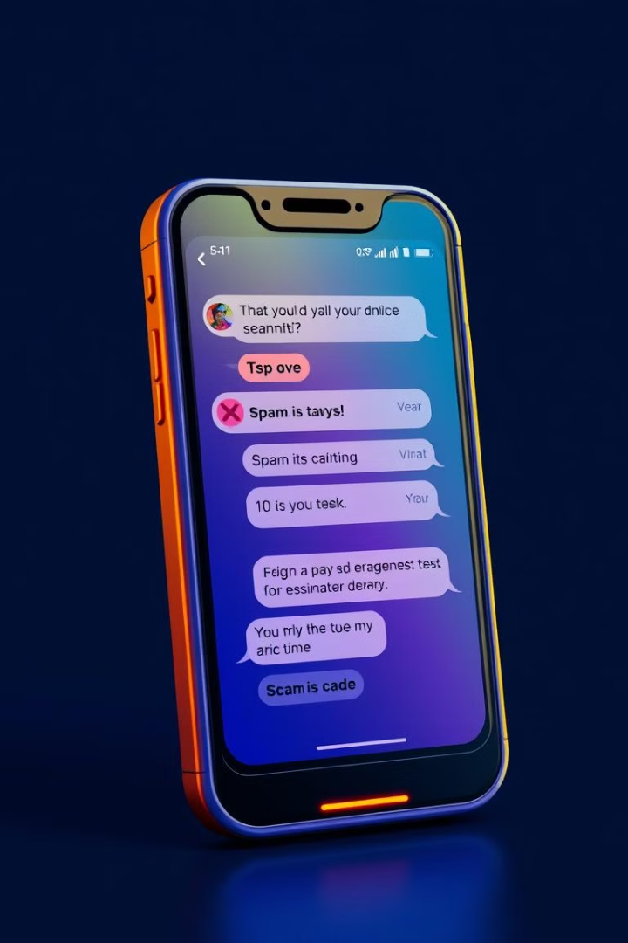
Spam Detection of Phishing SMS Using Machine Learning
Detecting and classifying phishing SMS messages as spam using machine learning models.
VIBHOR SINHA (22052867)
RITESH KUMAR SAHOO (22053973)
ROHIT OJHA (2205839)
PRANJAL GAUR (22051444)
Section: CSE 48

Slide 2

Project Outline
1
Introduction
2
Related Works
3
Dataset Description
4
Models Used
5
Results
6
Conclusion
7
References

Slide 3

Introduction & Objective
Objective
Problem
Detect and classify phishing SMS as spam using ML models.
Phishing SMS leads to fraud and data breaches.
Solution
Analyze SMS content using ML to classify messages.

Slide 4
Related Works
Comparative Study
Phishing Detection
SMS Spam Filtering
This paper compares various ML algorithms like Naive Bayes, SVM, and Decision Trees for spam detection in emails and SMS. It highlights the effectiveness of ensemble methods like Random Forest.
This research focuses on using NLP techniques (e.g., TF-IDF, word embeddings) combined with ML models to detect phishing messages. It emphasizes the importance of text preprocessing.
This study evaluates the performance of classifiers like Logistic Regression and KNN on SMS datasets. It concludes that Logistic Regression performs well for text classification tasks.

Slide 5




Dataset Description
Text
SMS message content.
Label
Binary classification (spam or ham).
Size
5,574 SMS messages with 747 spam messages and 4,827 ham messages.

Slide 6





Models Used
KN
Distance-based classifier.
DT
Tree-based model.
LR
Linear model with L1 penalty.
RF
Ensemble of decision trees.

Slide 7
Results
Algorithm
Accuracy
Precision
KN
0.9067
1.0000
ETC
0.9677
1.0000
RF
0.9605
0.9913
LR
0.9695
0.9843
XGB
0.9650
0.9837
BgC
0.9650
0.9760
GBDT
0.9381
0.9587
DT
0.9058
0.9206
AdaBoost
0.9121
0.8947
SVC
0.9291
0.8211

Slide 8

Result
Best Accuracy: Logistic Regression (96.95%)
Best Precision: KNN, ETC (100%)
"The results show that Logistic Regression and Extra Trees Classifier performed exceptionally well, with high accuracy and precision for detecting spam messages."
Accuracy
Precision

Slide 9
Conclusion & Future Work
1
Summary
2
Best Model
3
Future Work
Successfully implemented machine learning models to detect phishing SMS, demonstrating feasibility for spam detection.
Logistic Regression outperformed other models in accuracy and precision, indicating its suitability for this task. Ensemble methods like Random Forest and Extra Trees also performed well
Explore deep learning models like like LSTM or BERT for better text classification
Increase the dataset size and include more diverse phishing examples.
Deploy the model as a real-time SMS filtering system.

Slide 10
References
Dataset Source:
The spam.csv dataset is publicly available on Kaggle or the UCI Machine Learning Repository.
Research Papers:
Almeida, T. A., & Hidalgo, J. M. G. (2011). "SMS Spam Collection v.1" [Dataset].
Zhang, Y., & Yang, Q. (2018). "A Survey on Multi-Task Learning". arXiv preprint arXiv:1707.08114.
Kowsari, K., et al. (2019). "Text Classification Algorithms: A Survey". Information, 10(4), 150

Slide 11
Questions and Answers
This slide is open for any questions from the audience.

